Slide 1
INDIAN ARMED FORCES

Slide 2
CONTENTS
INTRODUCTION TOO INDIAN ARMY
ORGANISATION STRUCTURE
CATEGORIES IN INDIAN ARMY
COMMANDS
LATEST ACQUISION AND WEAPONS USED BY INDIAN ARMY
HISTORY AND OPERATIONS CONDUCTED BY INDIAN ARMY
ROLE IN NATION BUILDING

Slide 3
INTRODUCTION (INDIAN ARMY)
Land based branch and largest component of the Indian Armed Forces.
MOTTO:- Service Before Self (Seva Paramo Dharmah).
Largest Standing Volunteer Army- 1,237,117 active personnel and 960,000 reserve personnel.
Primary Mission :-Ensure national security and defense of the Nation from external aggression and threats.
Maintain peace and security within its borders.
Humanitarian rescue operations during natural calamities and other disturbances. Headed by Chief of Army Staff (COAS).

Slide 4
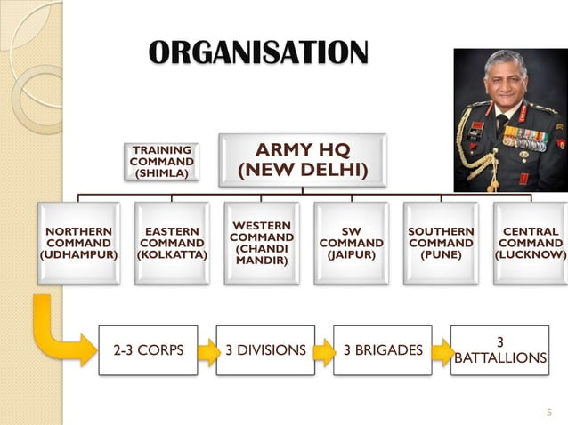
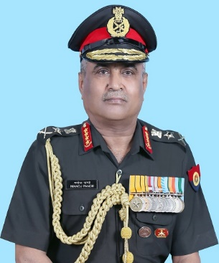

Slide 5
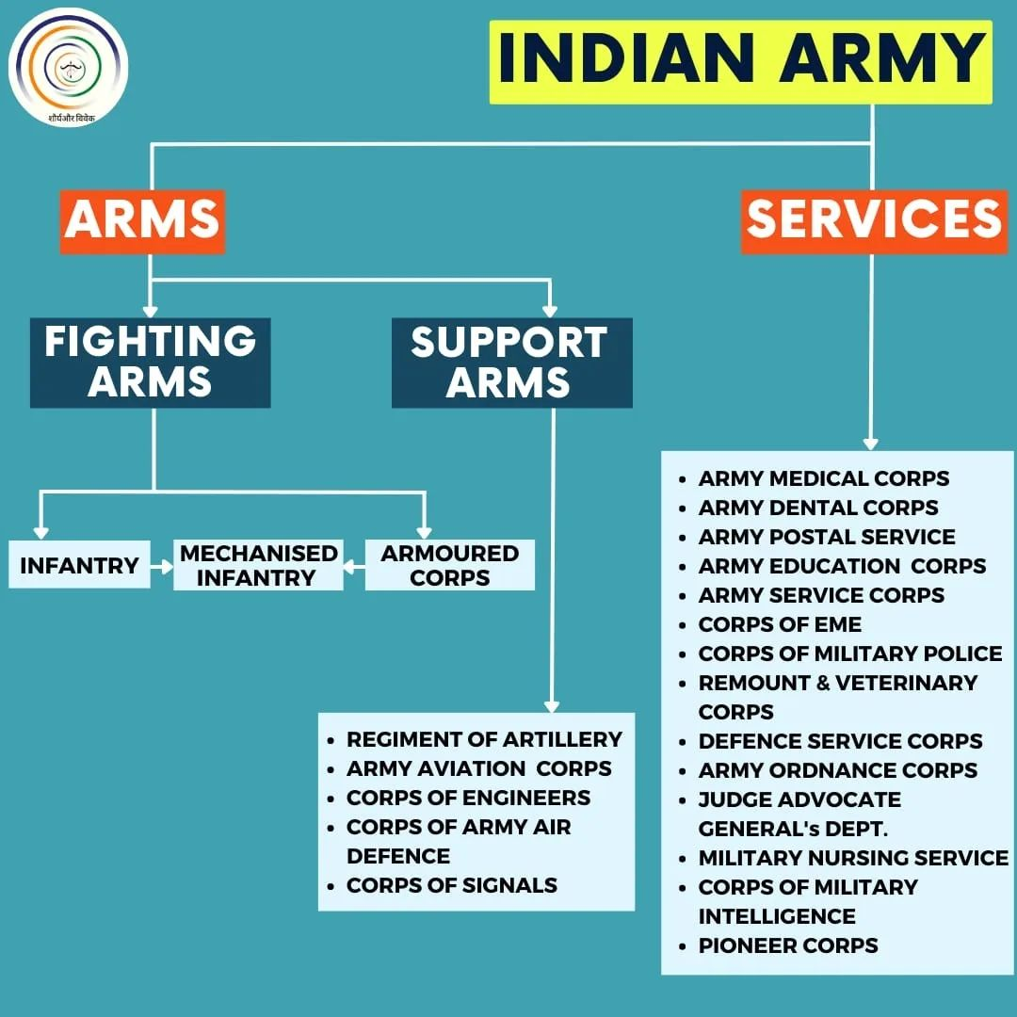

Slide 6
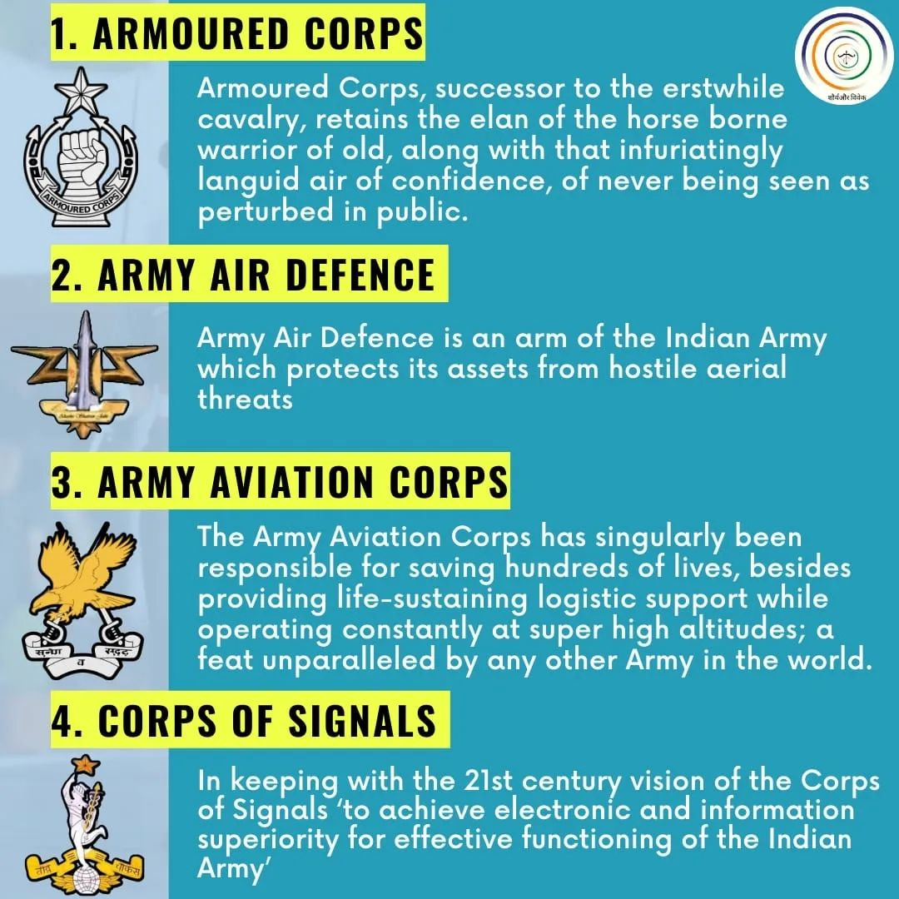

Slide 7
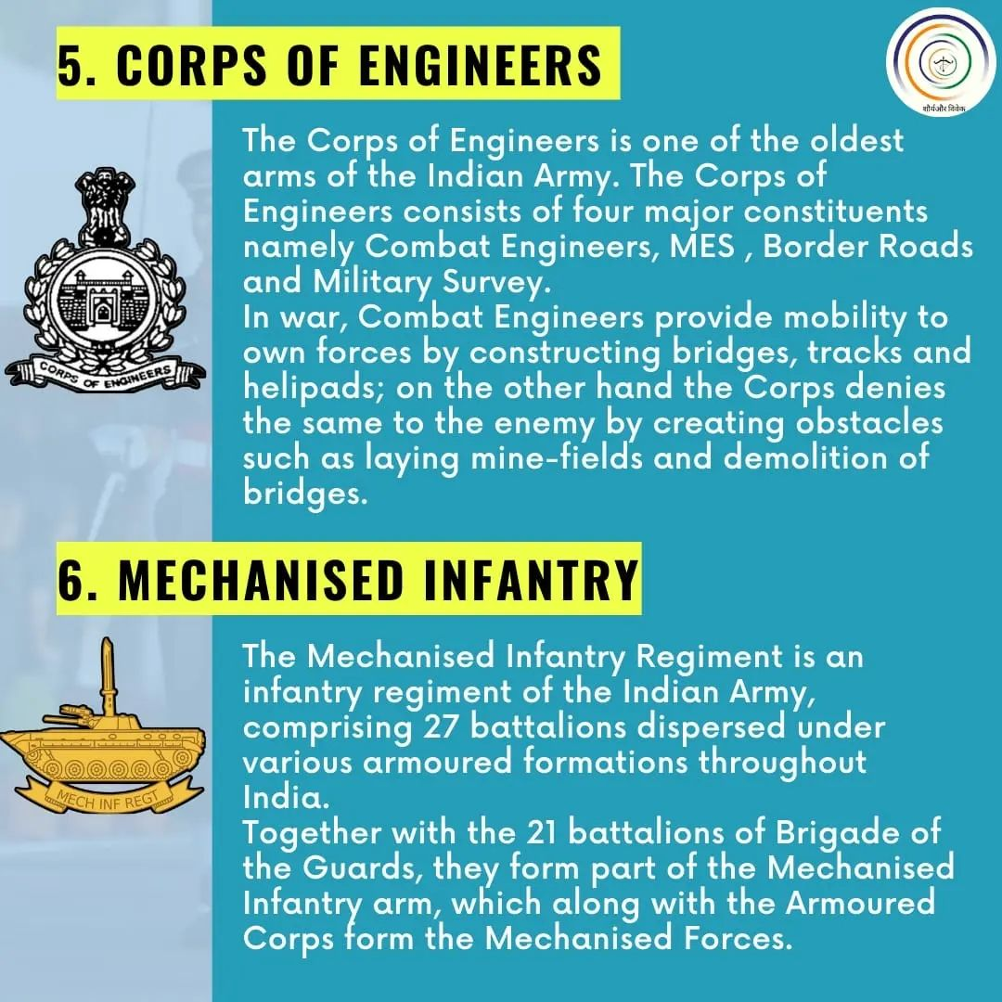

Slide 8
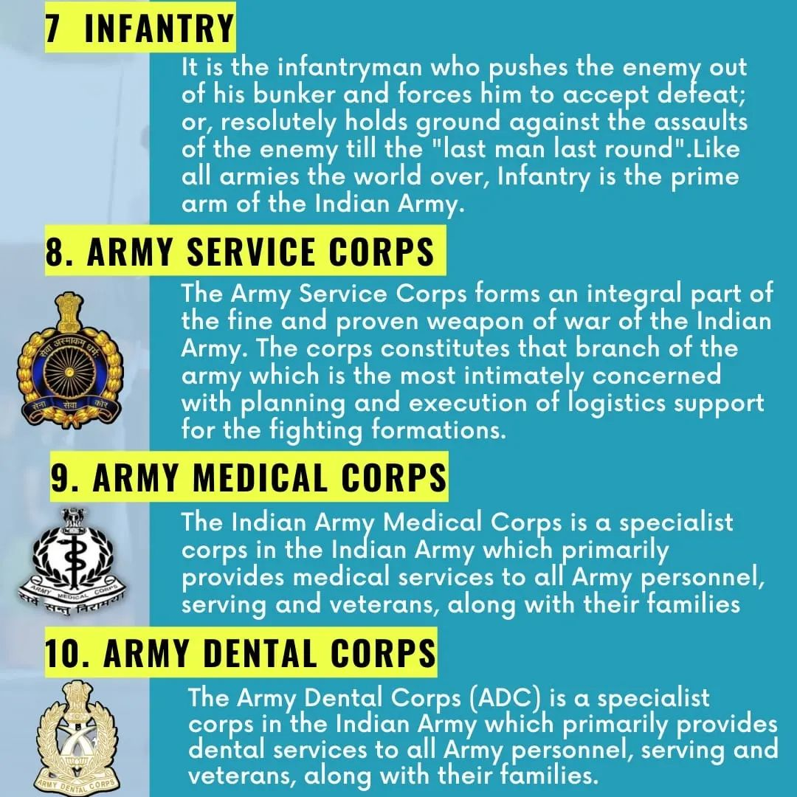

Slide 9
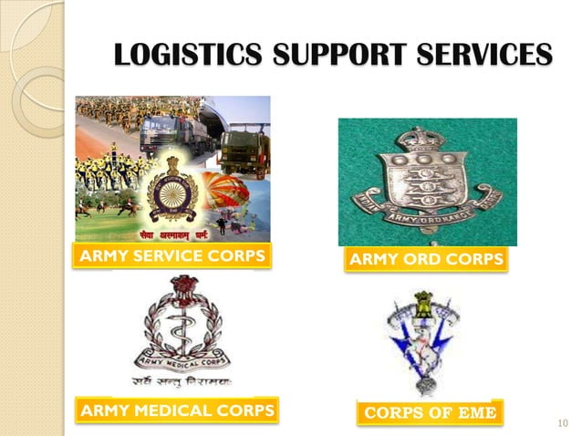

Slide 10
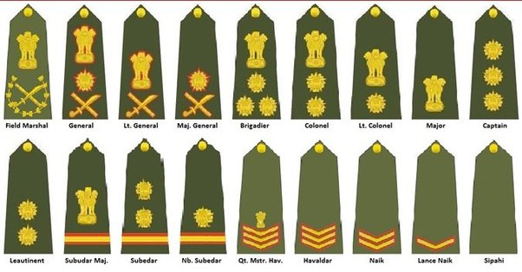
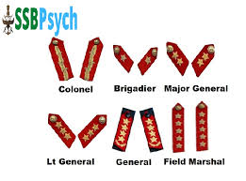
OFFICERS AND JCO’S/NCO/JAWANS
RANK INSIGNIA
GORGET PATCHES

Slide 11
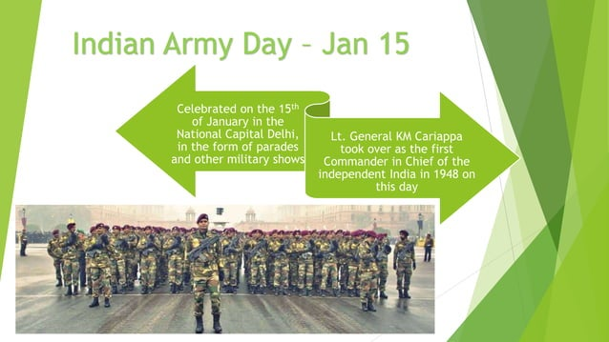

Slide 12
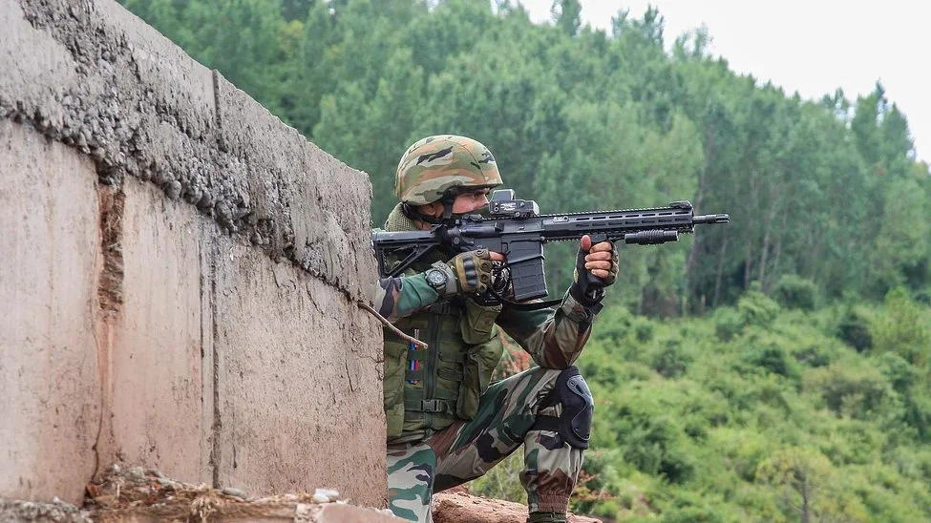
LIST OF WEAPONS USED BY INDIAN ARMY
ASSAULT RIFLES :-
INSAS: (Indian Small Arms System): The INSAS is the primary assault rifle of the Indian Army. It is a gas-operated, selective-fire rifle that fires the 5.56x45mm NATO round.
AK-47: The Indian Army also uses a large number of AK-47 rifles, which are widely used by its troops. These rifles are imported from countries like Russia and Romania.
AK-74: The AK-74 is a variant of the AK-47 that fires the 5.45x39mm round. The Indian Army has a small number of AK-74 rifles in its inventory.
TAR-21 (Tavor): The TAR-21 is an Israeli-made assault rifle that fires the 5.56x45mm NATO round. The Indian Army uses this rifle primarily in counter-terrorism operations.
TAR-21 (TAVOR)

Slide 13
M16A2: The M16A2 is an American-made assault rifle that fires the 5.56x45mm NATO round. The Indian Army has a small number of M16A2 rifles in its inventory.
SIG Sauer 716: The SIG Sauer 716 is a modern assault rifle that fires the 7.62x51mm NATO round. The Indian Army has recently purchased a large number of these rifles to replace the INSAS.
AK-103: The AK-103 is a modern variant of the AK-47 that fires the 7.62x39mm round. The Indian Army has recently purchased a large number of these rifles to replace the INSAS.
Excalibur: The Excalibur is an indigenous assault rifle that is currently under development by the Indian Army. It is designed to replace the INSAS in the future.

Slide 14
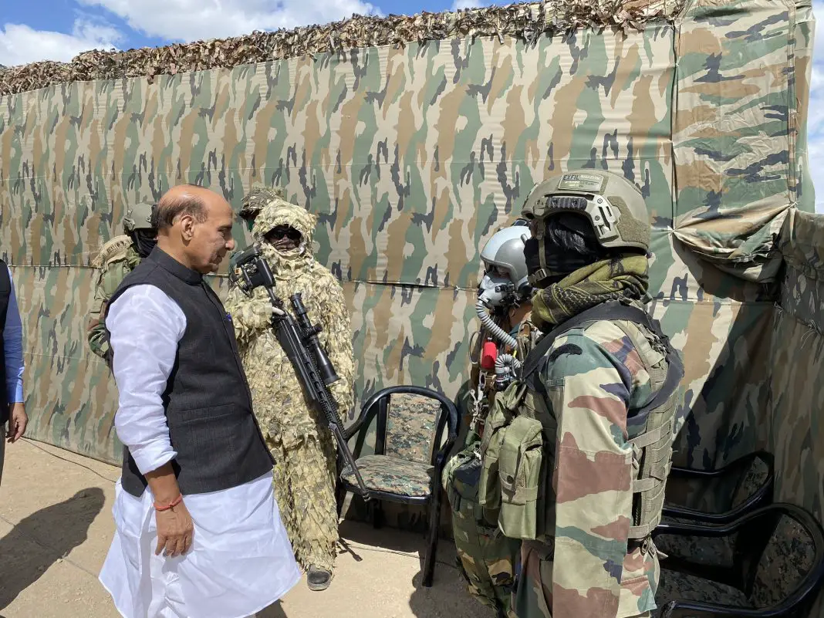
SNIPER RIFLES :-
Vidhwansak: The Vidhwansak is an indigenous sniper rifle that fires the 7.62x51mm NATO round. It has a range of up to 1,200 meters and is used by the Indian Army’s infantry units.
Barrett M95: The Barrett M95 is an American-made sniper rifle that fires the .50 BMG round. It has a range of up to 1,800 meters and is used by the Indian Army’s special forces units.
Beretta Scorpio TGT: The Beretta Scorpio TGT is an Italian-made sniper rifle that fires the .338 Lapua Magnum round. It has a range of up to 1,500 meters and is used by the Indian Army’s special forces units.
Sako TRG-42: The Sako TRG-42 is a Finnish-made sniper rifle that fires the .338 Lapua Magnum round. It has a range of up to 1,500 meters and is used by the Indian Army’s special forces units.
Sako TRG-42

Slide 15
Dragunov: The Dragunov is a Russian-made sniper rifle that fires the 7.62x54mmR round. It has a range of up to 800 meters and is used by the Indian Army’s infantry units.
Accuracy International Arctic Warfare: The Accuracy International Arctic Warfare is a British-made sniper rifle that fires the .338 Lapua Magnum round. It has a range of up to 1,500 meters and is used by the Indian Army’s special forces units.
PSG1: The PSG1 is a German-made sniper rifle that fires the 7.62x51mm NATO round. It has a range of up to 800 meters and is used by the Indian Army’s special forces units.

Slide 16
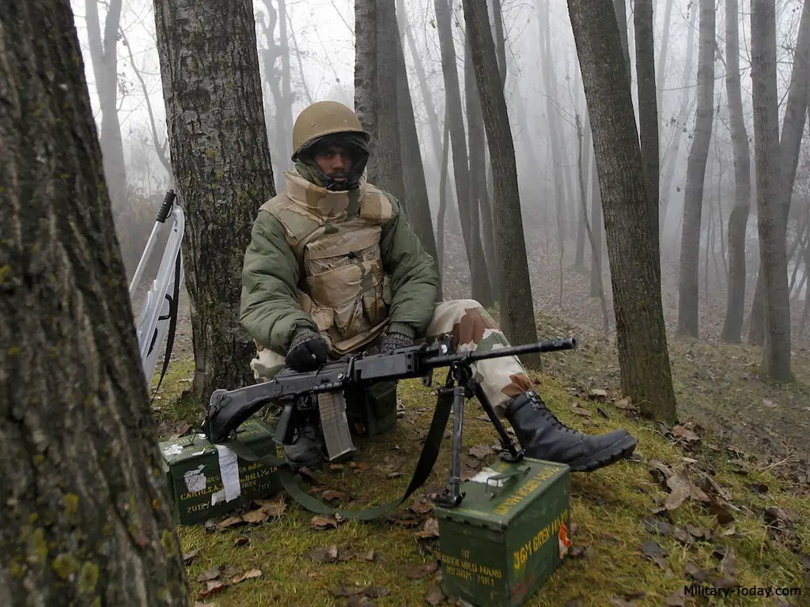
MACHINE GUNS :-
INSAS LMG: The INSAS LMG (Light Machine Gun) is a belt-fed machine gun that fires the 5.56x45mm NATO round. It has a cyclic rate of fire of 650 rounds per minute and is used by the Indian Army’s infantry units.
FN MAG: The FN MAG (Mitrailleuse d’Appui Général) is a Belgian-made machine gun that fires the 7.62x51mm NATO round. It has a cyclic rate of fire of 650-1,000 rounds per minute and is used by the Indian Army’s infantry and special forces units.
PKM: The PKM (Pulemyot Kalashnikova Modernizirovannyi) is a Russian-made machine gun that fires the 7.62x54mmR round. It has a cyclic rate of fire of 650-800 rounds per minute and is used by the Indian Army’s infantry units.
INSAS LMG

Slide 17
Browning M2: The Browning M2 is an American-made heavy machine gun that fires the .50 BMG round. It has a cyclic rate of fire of 450-600 rounds per minute and is used by the Indian Army’s infantry and special forces units.
NSV: The NSV (Nikitin-Shevchenko Vintovka) is a Russian-made heavy machine gun that fires the 12.7x108mm round. It has a cyclic rate of fire of 700-800 rounds per minute and is used by the Indian Army’s infantry and special forces units.
DShK: The DShK (Degtyaryov-Shpagin Krupnokaliberny) is a Russian-made heavy machine gun that fires the 12.7x108mm round. It has a cyclic rate of fire of 600-800 rounds per minute and is used by the Indian Army’s infantry units.
ZU-23-2: The ZU-23-2 is a Russian-made anti-aircraft gun that fires the 23x152mmB round. It has a cyclic rate of fire of 200-2,000 rounds per minute and is used by the Indian Army’s air defense units.

Slide 18
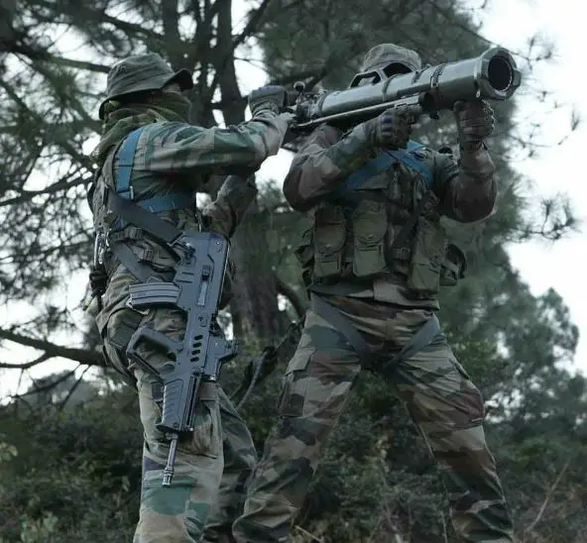
GRENADE LAUNCHERS :-
AGS-30: The AGS-30 is a Russian-made automatic grenade launcher that fires 30mm grenades. It has a range of up to 1,700 meters and is used by the Indian Army’s infantry and special forces units.
MM-1: The MM-1 is an American-made 40mm multiple grenade launcher that can fire up to six grenades in rapid succession. It has a range of up to 400 meters and is used by the Indian Army’s infantry units.
HK GMG: The HK GMG (Heckler & Koch Grenade Machine Gun) is a German-made automatic grenade launcher that fires 40mm grenades. It has a range of up to 1,800 meters and is used by the Indian Army’s special forces units.
Carl Gustav: The Carl Gustav is a Swedish-made recoilless rifle that can fire both anti-tank and high-explosive rounds. It has a range of up to 1,000 meters and is used by the Indian Army’s infantry and special forces units.
CARL GUSTAV

Slide 19
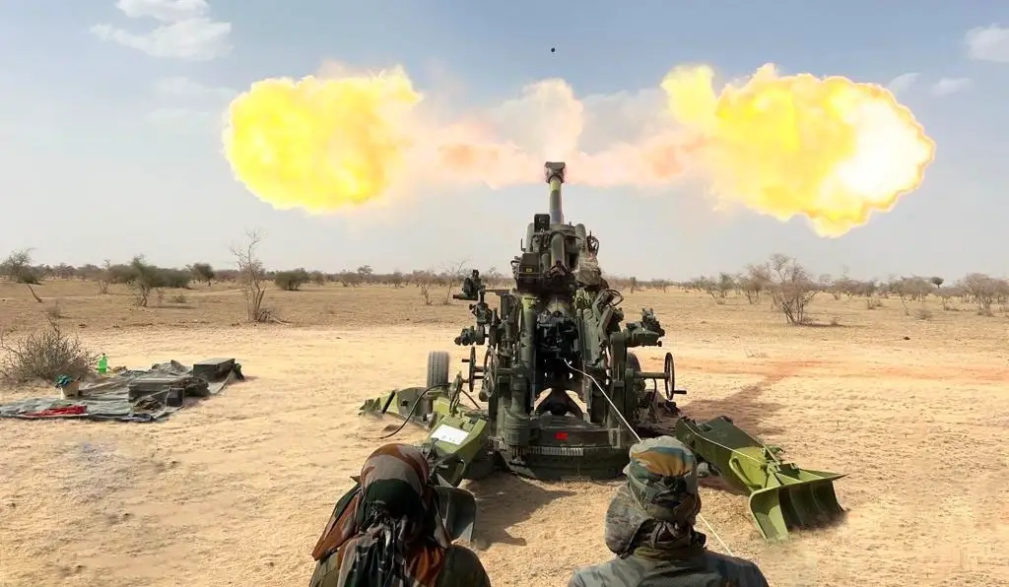
ARTILLERY :-
Bofors 155mm Howitzer: The Bofors 155mm Howitzer is a Swedish-made artillery gun that can fire up to 4 rounds per minute to a range of up to 30 km. It is widely used by the Indian Army and is considered one of its most effective artillery systems.
M777 Howitzer: The M777 Howitzer is an American-made lightweight artillery gun that can be easily airlifted to high altitude and mountainous areas. It can fire up to 5 rounds per minute to a range of up to 30 km.
Dhanush Artillery Gun: The Dhanush Artillery Gun is an indigenous 155mm howitzer developed by the Indian Army’s Ordnance Factory Board. It can fire up to 6 rounds per minute to a range of up to 38 km.
Pinaka Multi-Barrel Rocket Launcher: The Pinaka Multi-Barrel Rocket Launcher is an Indian-made artillery system that can fire 12 rockets in just 44 seconds. It has a range of up to 40 km and is used by the Indian Army’s artillery units.
M777 HOWITZER

Slide 20
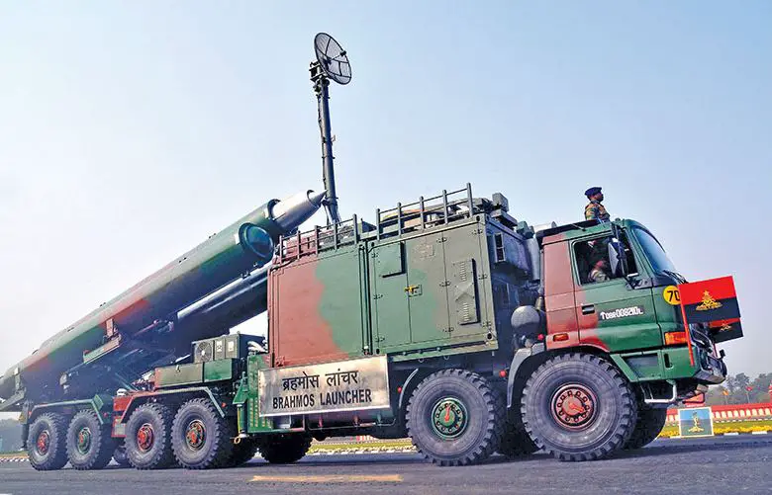
MISSILES :-
BrahMos: The BrahMos is a supersonic cruise missile jointly developed by India and Russia. It has a range of up to 290 km and can be launched from land, sea, and air platforms. The Indian Army has deployed the land-based variant of the BrahMos missile.
Nag: The Nag is an anti-tank missile developed indigenously by India. It has a range of up to 4 km and can be launched from ground-based and helicopter platforms. The Nag missile uses infrared imaging and has a top-attack capability to defeat armored targets.
Akash: The Akash is a surface-to-air missile developed by India. It has a range of up to 30 km and is used for air defense of ground assets against enemy aircraft, helicopters, and UAVs. The Akash missile uses a command guidance system and has an electronic counter-countermeasures capability.
BRAHMOS

Slide 21
Prithvi: The Prithvi is a surface-to-surface ballistic missile developed by India. It has a range of up to 350 km and can carry both conventional and nuclear warheads. The Indian Army has deployed the short-range variant of the Prithvi missile.
Shaurya: The Shaurya is a hypersonic surface-to-surface missile developed by India. It has a range of up to 750 km and can carry conventional warheads. The Shaurya missile can be launched from land-based platforms.
Astra: The Astra is an air-to-air missile developed by India. It has a range of up to 110 km and is used by the Indian Air Force and Indian Navy. The Astra missile uses an active radar seeker and can engage targets at high altitudes and speeds.
Prahaar: The Prahaar is a short-range ballistic missile developed by India. It has a range of up to 150 km and can carry conventional warheads. The Prahaar missile can be launched from a mobile launcher and is primarily used for battlefield support.

Slide 22
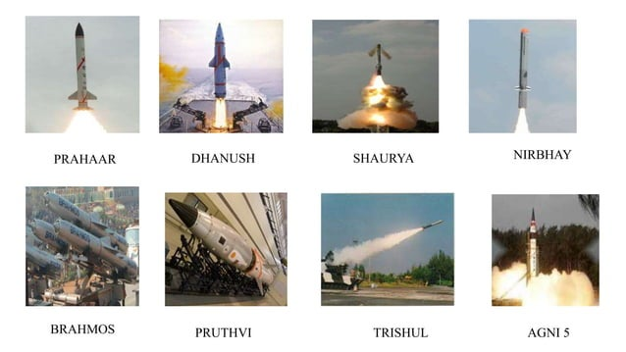

Slide 23
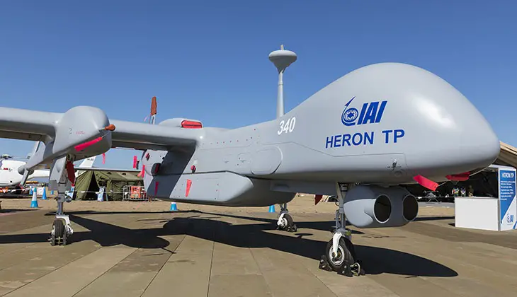
UAV’S :-
Searcher Mk II: The Searcher Mk II is a medium-range, multi-mission UAV used for surveillance, reconnaissance, and target acquisition. It has a range of up to 300 km and can operate at an altitude of up to 7 km. The Searcher Mk II is equipped with day and night vision sensors and can transmit real-time video and imagery.
Heron: The Heron is a medium-altitude, long-endurance UAV used for reconnaissance, surveillance, and target acquisition. It has a range of up to 350 km and can operate at an altitude of up to 9 km. The Heron is equipped with a synthetic aperture radar, electro-optical/infrared sensors, and can transmit real-time video and imagery.
Nishant: The Nishant is a medium-range, autonomous UAV used for reconnaissance, surveillance, and target acquisition. It has a range of up to 100 km and can operate at an altitude of up to 3.5 km. The Nishant is equipped with a day/night camera and can transmit real-time video and imagery.
HERON

Slide 24
Panchi: The Panchi is a micro-UAV used for surveillance and reconnaissance. It has a range of up to 10 km and can operate at an altitude of up to 1.5 km. The Panchi is equipped with a day/night camera and can transmit real-time video and imagery.
Netra: The Netra is a small, portable UAV used for surveillance and reconnaissance. It has a range of up to 2 km and can operate at an altitude of up to 200 meters. The Netra is equipped with a day/night camera and can transmit real-time video and imagery.
Skylark: The Skylark is a small, portable UAV used for surveillance and reconnaissance. It has a range of up to 10 km and can operate at an altitude of up to 1.5 km. The Skylark is equipped with a day/night camera and can transmit real-time video and imagery.
Raven: The Raven is a small, hand-launched UAV used for reconnaissance and surveillance. It has a range of up to 10 km and can operate at an altitude of up to 500 meters. The Raven is equipped with a day/night camera and can transmit real-time video and imagery.

Slide 25
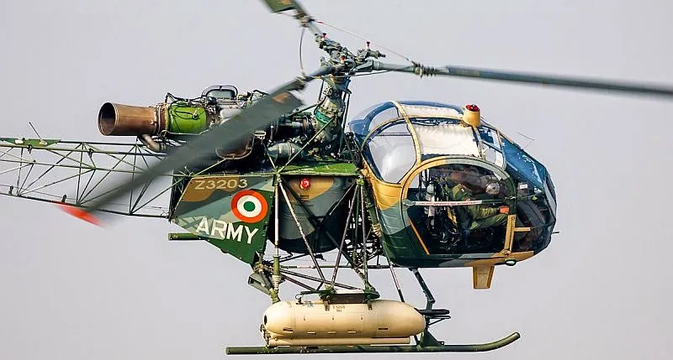
AIRCRAFT :-
HAL Dhruv: The HAL Dhruv is a multi-role helicopter manufactured by Hindustan Aeronautics Limited. It is used by the Indian Army for reconnaissance, surveillance, and troop transport. It has a maximum speed of 290 km/h and a range of up to 640 km.
Mi-17: The Mi-17 is a transport helicopter manufactured by the Russian company Mil. It is used by the Indian Army for troop transport, logistics, and casualty evacuation. It has a maximum speed of 250 km/h and a range of up to 580 km.
CH-47 Chinook: The CH-47 Chinook is a heavy-lift helicopter manufactured by the American company Boeing. It is used by the Indian Army for troop transport, logistics, and heavy equipment transport. It has a maximum speed of 315 km/h and a range of up to 1,100 km.
CHEETAH

Slide 26
ALH Rudra: The ALH Rudra is a weaponized version of the HAL Dhruv helicopter. It is used by the Indian Army for reconnaissance, surveillance, and close air support. It is equipped with rockets, missiles, and guns for ground attack.
Cheetah: The Cheetah is a light helicopter manufactured by Aerospatiale. It is used by the Indian Army for reconnaissance, surveillance, and casualty evacuation. It has a maximum speed of 185 km/h and a range of up to 530 km.
Chetak: The Chetak is a light helicopter manufactured by Aerospatiale. It is used by the Indian Army for troop transport, logistics, and reconnaissance. It has a maximum speed of 225 km/h and a range of up to 500 km.

Slide 27
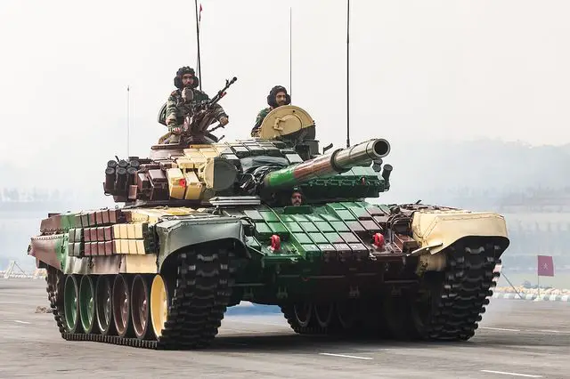
TANKS :-
Arjun Main Battle Tank (MBT): This is India’s first indigenously designed and developed tank. The Arjun MBT is equipped with a 120 mm main gun, a 7.62 mm coaxial machine gun, and a 12.7 mm anti-aircraft machine gun.
T-90S Bhishma: This is a Russian-made tank that was inducted into the Indian Army in 2001. The T-90S is equipped with a 125 mm smoothbore gun, a 7.62 mm coaxial machine gun, and a 12.7 mm anti-aircraft machine gun.
T-72M1: This is a Soviet-made tank that was inducted into the Indian Army in the 1970s. The T-72M1 is equipped with a 125 mm smoothbore gun, a 7.62 mm coaxial machine gun, and a 12.7 mm anti-aircraft machine gun.
ARJUN

Slide 28
Ajeya: This is an Indian version of the Soviet T-72M1 tank. It has been modified to suit Indian requirements and is equipped with a 125 mm smoothbore gun, a 7.62 mm coaxial machine gun, and a 12.7 mm anti-aircraft machine gun.
Vijayanta: This is an Indian-made tank that was in service with the Indian Army from 1965 to 2003. The Vijayanta was equipped with a 105 mm rifled gun, a 7.62 mm coaxial machine gun, and a 12.7 mm anti-aircraft machine gun.
BMP-2: This is a Soviet-made infantry fighting vehicle that is used by the Indian Army. It is equipped with a 30 mm automatic cannon, a 7.62 mm machine gun, and an anti-tank guided missile launcher.
BMP-1: This is a Soviet-made infantry fighting vehicle that was in service with the Indian Army until it was replaced by the BMP-2. It is equipped with a 73 mm smoothbore gun, a 7.62 mm machine gun, and an anti-tank guided missile launcher.
Casspir: This is a South African-made mine-protected vehicle that is used by the Indian Army for mine-clearing operations. It is equipped with a 7.62 mm machine gun.

Slide 29


Slide 30
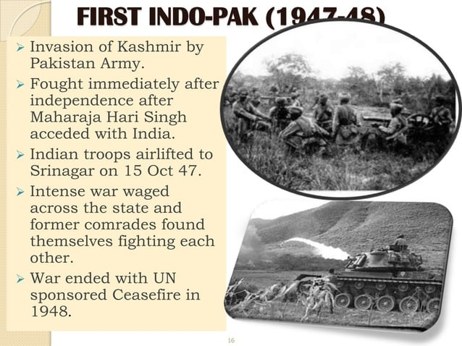

Slide 31
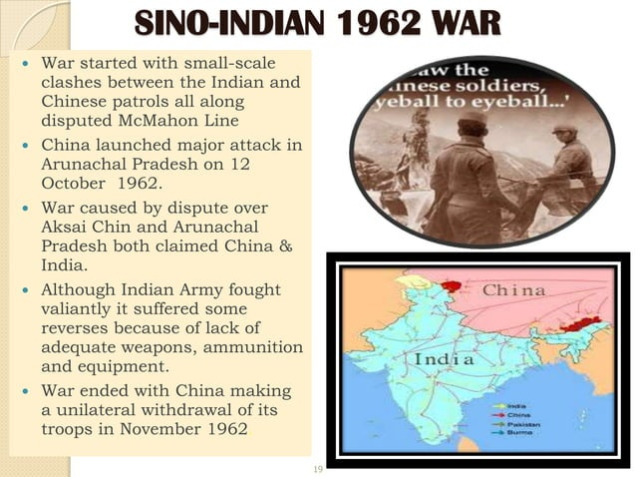

Slide 32
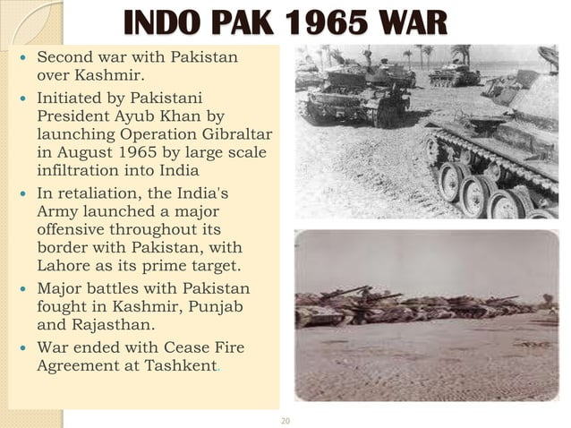

Slide 33
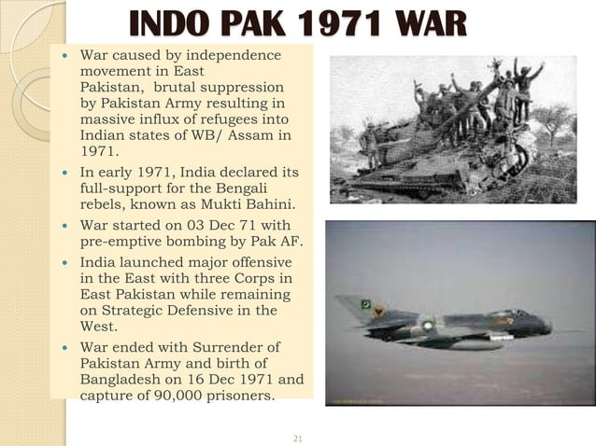

Slide 34
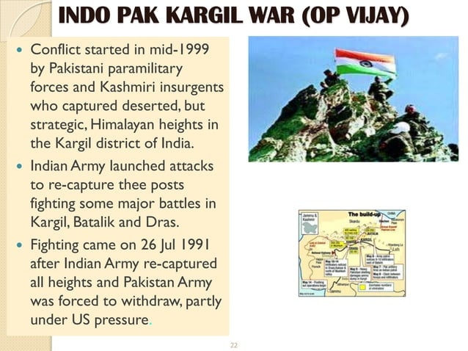

Slide 35


Slide 36
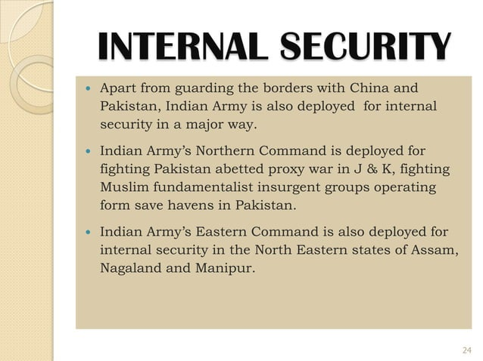

Slide 37
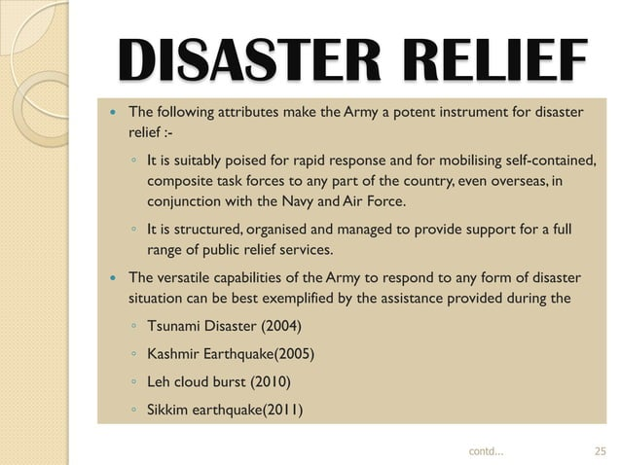

Slide 38


Slide 39


Slide 40
